Slide 1

Introduction to AWS VPC
Unlimited Powerful Learning
Definition of VPC:
A Virtual Private Cloud (VPC) is a public cloud offering that lets an enterprise establish its own private cloud-like computing environment on shared public cloud infrastructure. A VPC gives an enterprise the ability to define and control a virtual network that is logically isolated from all other public cloud tenants, creating a private, secure place on the public cloud.
Importance of VPC in AWS architecture:
AWS VPC is a secure, isolated private cloud hosted within AWS public cloud which contains reserved AWS resources, objects and services for each user. It is a critical component of the AWS cloud infrastructure, offering a scalable and secure environment for deploying applications and services. VPC enables you to launch AWS resources such as EC2, RDS, ELB, etc. into a virtual network that you’ve defined. This virtual network closely resembles a traditional network that you’d operate in your own data center, with the benefits of using the scalable infrastructure of AWS.

Slide 2
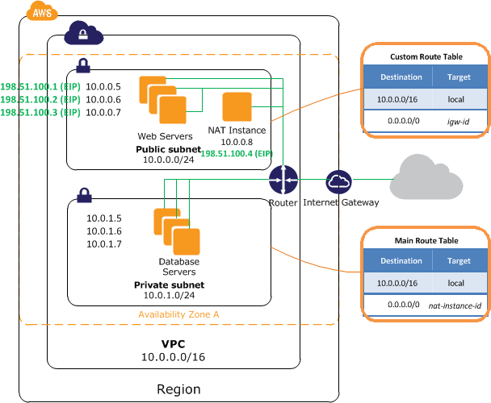
VPC Architecture
Unlimited Powerful Learning

Slide 3
VPC Components
Unlimited Powerful Learning
Key VPC components:
Subnets
Route Tables
Network ACLs
Security Groups

Slide 4
Subnets and IP Addressing
Unlimited Powerful Learning
Explanation of subnets:
A subnet is a network inside a network. Subnets make networks more efficient. Through subnetting, network traffic can travel a shorter distance without passing through unnecessary routers to reach its destination.
Private vs public subnets:
A public subnet is a subnet that is associated with a route table that has a route to an Internet gateway. A private subnet is a subnet that is associated with a route table that does not have a route to an Internet gateway.
IPv4 and IPv6 addressing within VPC:
VPC can operate in dual-stack mode — your resources can communicate over IPv4, or IPv6, or both. IPv4 and IPv6 communication are independent of each other. You cannot disable IPv4 support for your VPC and subnets; this is the default IP addressing system for Amazon VPC and Amazon EC2.
IPv6 addresses are only supported for the inside IP addresses of the VPN tunnels. The outside tunnel IP addresses for the AWS endpoints are IPv4 addresses, and the public IP address of your customer gateway must be an IPv4 address. Site-to-Site VPN connections on a virtual private gateway do not support IPv6.

Slide 5
Routing in VPC
Unlimited Powerful Learning
How routing works in VPC:
Amazon VPC uses route tables to direct traffic within the VPC and between the VPC and the internet. Each subnet in a VPC must be associated with a route table, which controls the traffic routing for the subnet.
Route tables and their associations:
A route table contains a set of rules, called routes, that determine where network traffic from your subnet or gateway is directed. A route table can be associated with zero or more subnets. Each subnet in your VPC must be associated with a route table, which controls the routing for the subnet (subnet route table). You can explicitly associate a subnet with a particular route table. Otherwise, the subnet is implicitly associated with the main route table. A subnet can only be associated with one route table at a time, but you can associate multiple subnets with the same subnet route table.

Slide 6
Secure Communication
Unlimited Powerful Learning
Security groups:
Security groups are a key AWS feature for managing network traffic to EC2 instances within a VPC. They act as a virtual firewall that controls the traffic allowed to and from the resources in your virtual private cloud (VPC). You can choose the ports and protocols to allow for inbound traffic and for outbound traffic. For each security group, you add separate sets of rules for inbound traffic and outbound traffic.
Best practices for network security:
Use security groups and network ACLs to control traffic.
Use IAM roles to control access to AWS resources.
Use Amazon VPC flow logs to monitor network traffic.
Use AWS WAF to protect web applications.
Use AWS Shield to protect against DDoS attacks.
Use AWS PrivateLink to access services privately.
Use AWS Direct Connect to establish a dedicated network connection between your data center and AWS.

Slide 7
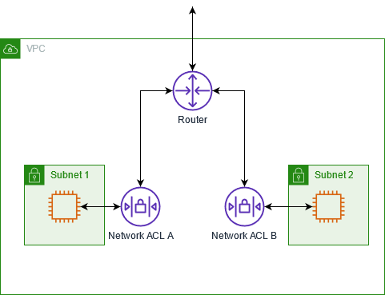
Unlimited Powerful Learning
Role of Network ACLs:
Network ACLs are stateless and operate at the subnet level. They provide an optional layer of security for your VPC that acts as a firewall for controlling traffic in and out of one or more subnets. Network ACLs are associated with subnets and evaluate traffic entering and exiting a subnet based on the rules you specify. Each subnet in your VPC must be associated with a network ACL; the rules of the network ACL are applied to all traffic entering and exiting the subnet.

Slide 8
Creating VPC, Subnets
Unlimited Powerful Learning
Create a VPC with two public subnets. AWS Directory Service requires two subnets in your VPC, and each subnet must be in a different Availability Zone.
(https://docs.aws.amazon.com/directoryservice/latest/admin-guide/gsg_create_vpc.html )
Open the Amazon VPC console at https://console.aws.amazon.com/vpc/.
In the VPC Dashboard, choose Create VPC.
Under VPC settings, choose VPC and more.
Complete these fields as follows:
Keep Auto-generated selected under Name tag auto-generation. Change project to ADS VPC.
The IPv4 CIDR block should be 10.0.0.0/16.
Keep No IPv6 CIDR block option selected.
The Tenancy should remain Default.
Select 2 for the Number of Availability Zones (AZs).
Select 2 for the Number of public subnets. The number of private subnets can be changed to 0.
Choose Customize subnet CIDR blocks to configure the public subnet IP address range. The public subnet CIDR blocks should be 10.0.0.0/20 and 10.0.16.0/20.
Choose Create VPC. It takes several minutes for the VPC to be created.

Slide 9
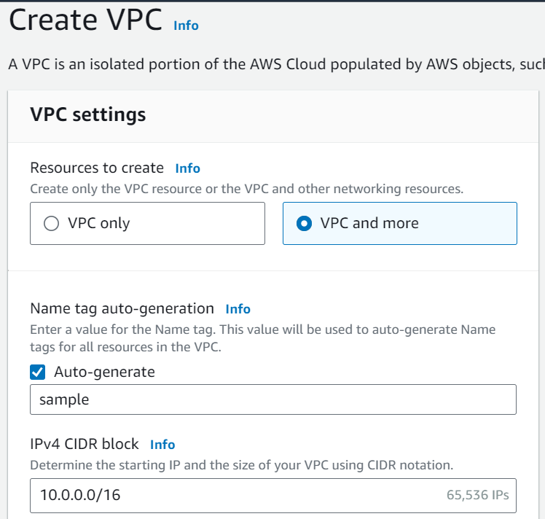
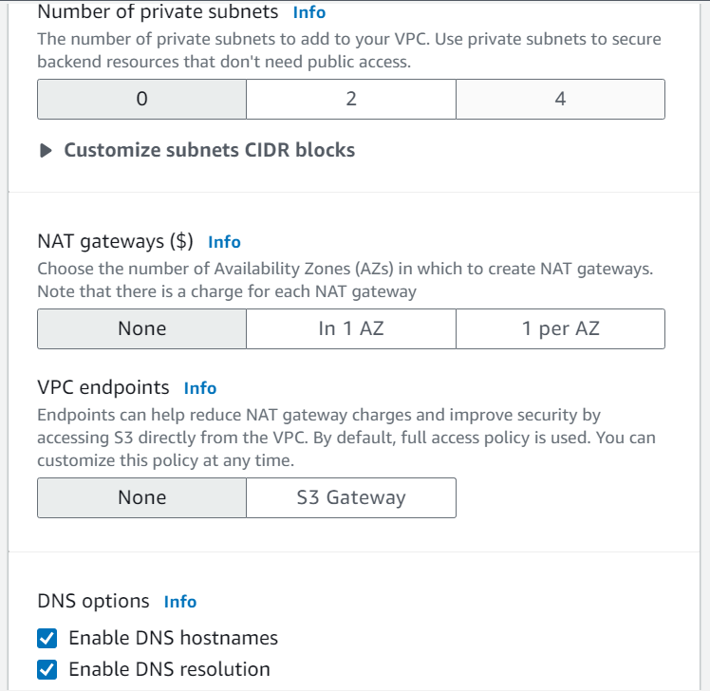
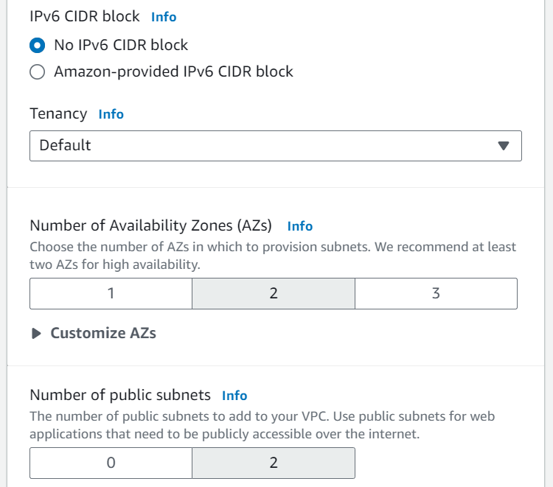
Unlimited Powerful Learning
Create VPC

Slide 10
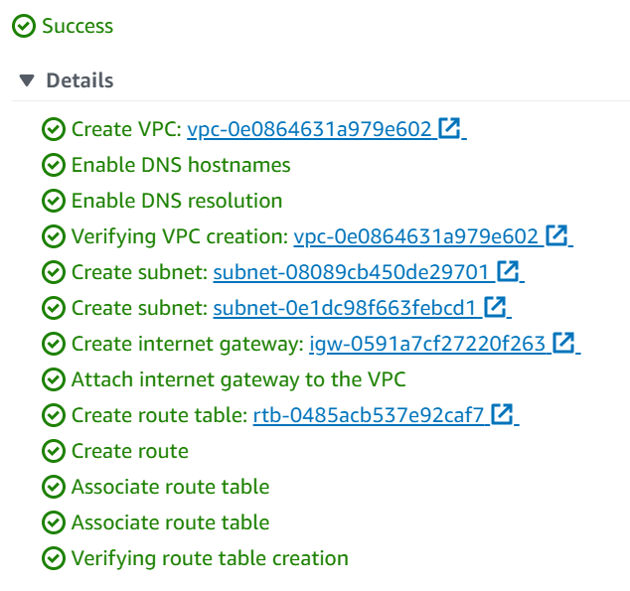
Unlimited Powerful Learning

Slide 11
Creating security group
Unlimited Powerful Learning
To create a security group using the console
( https://docs.aws.amazon.com/vpc/latest/userguide/security-groups.html )
Open the Amazon VPC console at https://console.aws.amazon.com/vpc/.
In the navigation pane, choose Security groups.
Choose Create security group.
Enter a name and description for the security group. You cannot change the name and description of a security group after it is created.
From VPC, choose the VPC.
You can add security group rules now, or you can add them later.
You can add tags now, or you can add them later. To add a tag, choose Add new tag and enter the tag key and value.
Choose Create security group.
After you create a security group, you can assign it to an EC2 instance when you launch the instance or change the security group currently assigned to an instance

Slide 12
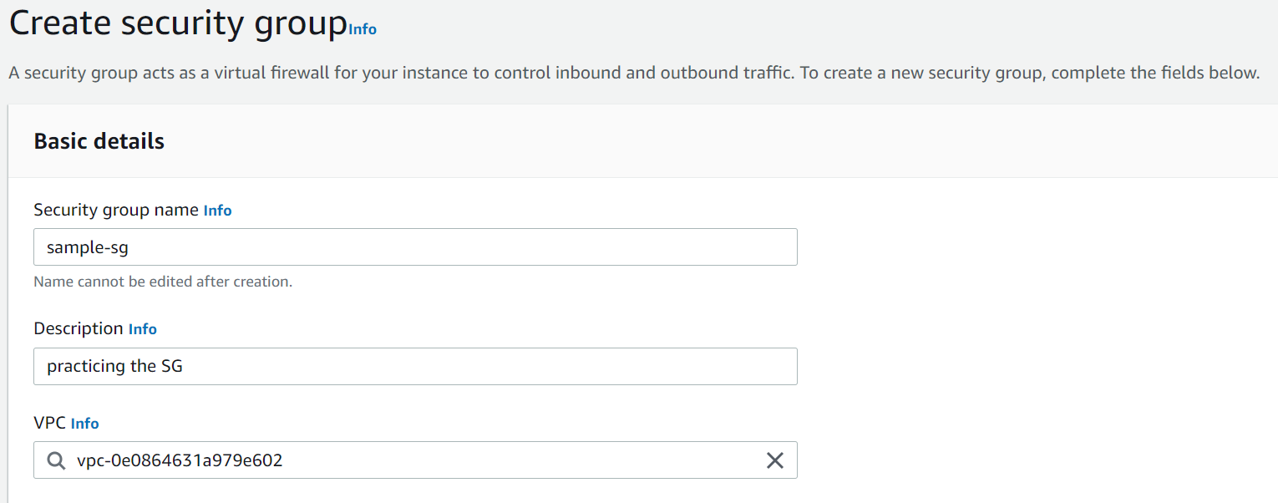
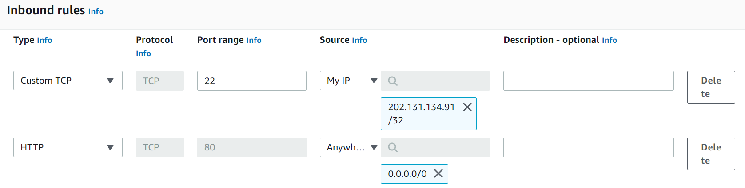
Unlimited Powerful Learning
egress -> outbound [from server to outside system]
ingress -> inbound [from outside to server]

Slide 13
Configuring Network ACLs
Unlimited Powerful Learning
Network ACL rules
( https://docs.aws.amazon.com/vpc/latest/userguide/vpc-network-acls.html )
You can add or remove rules from the default network ACL, or create additional network ACLs for your VPC. When you add or remove rules from a network ACL, the changes are automatically applied to the subnets that it's associated with.
The following are the parts of a network ACL rule:
Rule number. Rules are evaluated starting with the lowest numbered rule. As soon as a rule matches traffic, it's applied regardless of any higher-numbered rule that might contradict it.
Type. The type of traffic; for example, SSH. You can also specify all traffic or a custom range.
Protocol. You can specify any protocol that has a standard protocol number. If you specify ICMP as the protocol, you can specify any or all of the ICMP types and codes.
Port range. The listening port or port range for the traffic. For example, 80 for HTTP traffic.
Source. [Inbound rules only] The source of the traffic (CIDR range).
Destination. [Outbound rules only] The destination for the traffic (CIDR range).
Allow/Deny. Whether to allow or deny the specified traffic.

Slide 14
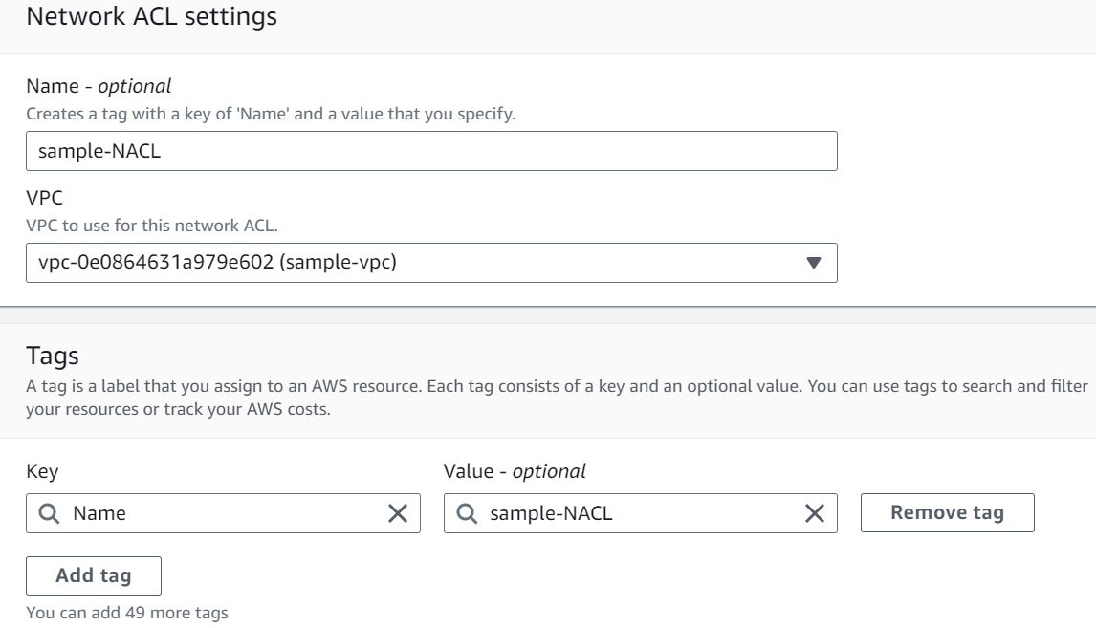
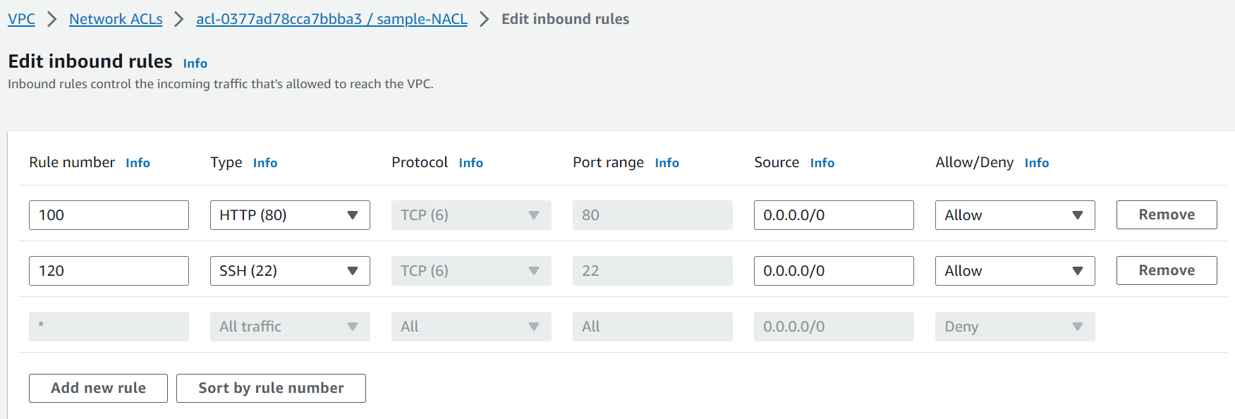
Unlimited Powerful Learning

Slide 15
Setting Up CloudFront Distribution
Unlimited Powerful Learning
Steps for creating a distribution
(https://docs.aws.amazon.com/AmazonCloudFront/latest/DeveloperGuide/distribution-web-creating.html )
To create a distribution
Create one or more Amazon S3 buckets or configure HTTP servers as your origin servers. An origin is the location where you store the original version of your content. When CloudFront gets a request for your files, it goes to the origin to get the files that it distributes at edge locations. You can use any combination of Amazon S3 buckets and HTTP servers as your origin servers. If you're using Amazon S3, note that the name of your bucket must be all lowercase and cannot contain spaces.
Upload your content to your origin servers. If you don't want to restrict access to your content using Cloud Front signed URLs, make the objects publicly readable.
Create your CloudFront distribution:
Sign in to the AWS Management Console and open the CloudFront console.
Choose Create distribution.
Specify settings for the distribution.
Save changes.
After CloudFront creates your distribution, the value of the Status column for your distribution will change from InProgress to Deployed. If you chose to enable the distribution, it will be ready to process requests after the status switches to Deployed.
The domain name that CloudFront assigns to your distribution appears in the list of distributions. (It also appears on the General tab for a selected distribution.)
When your distribution is deployed, confirm that you can access your content using your new CloudFront URL or CNAME.
Develop your website or application to access your content using the domain name that CloudFront returned after you created your distribution in Step 3. For example, if CloudFront returns d111111abcdef8.cloudfront.net as the domain name for your distribution, the URL for the file image.jpg in an Amazon S3 bucket or in the root directory on an HTTP server will be https://d111111abcdef8.cloudfront.net . If you specified one or more alternate domain names (CNAMEs) when you created your distribution, you can use your own domain name. In that case, the URL for image.jpg might be https://www.example.com/image.jpg.

Slide 16
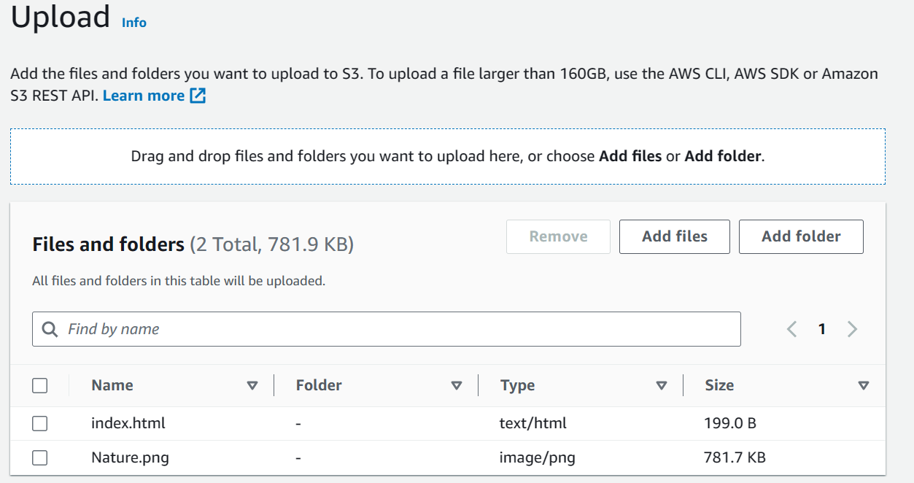
Unlimited Powerful Learning
Create one or more Amazon S3 buckets as your origin servers (an origin is the location where you store the original version of your content) and upload your content to your origin servers.

Slide 17
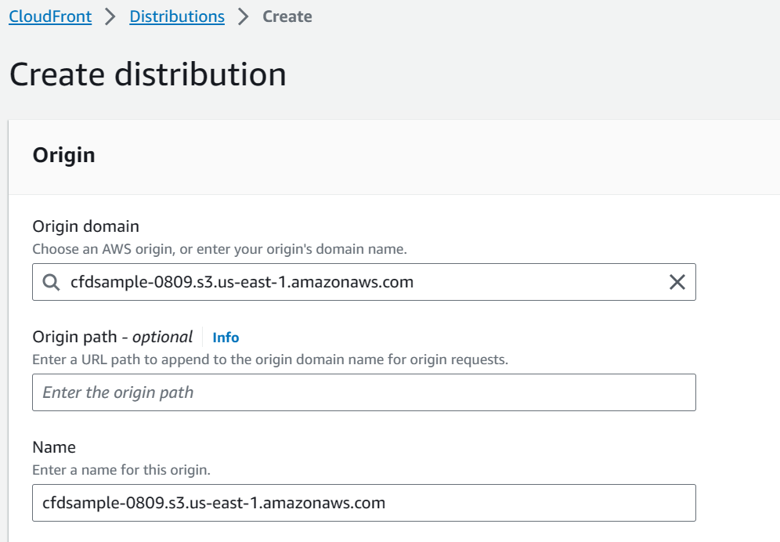
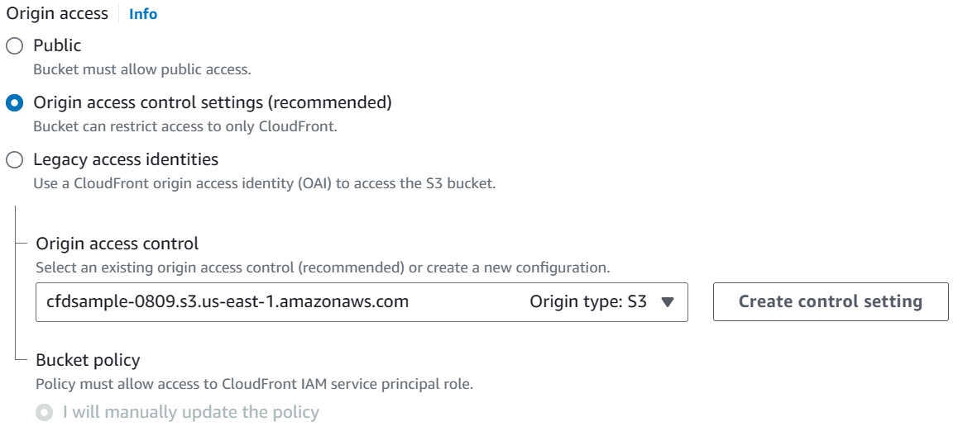
Unlimited Powerful Learning
While creating the distribution its ask for origin . In my case I am using S3 bucket as origin and select that origin server.
Under origin access let’s set to the recommended setting, which will give cloudfront access to things in bucket. And also we should setup origin access control, click on create control setting and select origin as S3 and save.

Slide 18
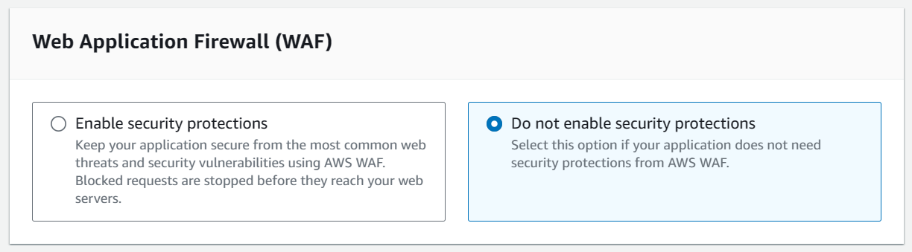
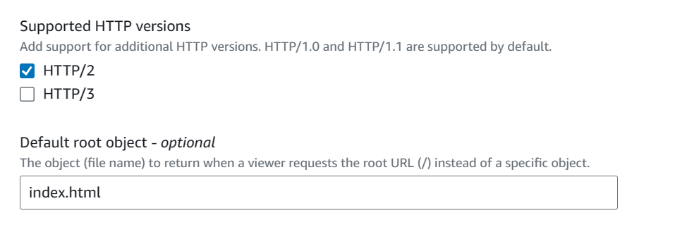
Unlimited Powerful Learning
And select the Do not enable security protections.
In default root object specify your web page name. afterwards click below create distribution

Slide 19
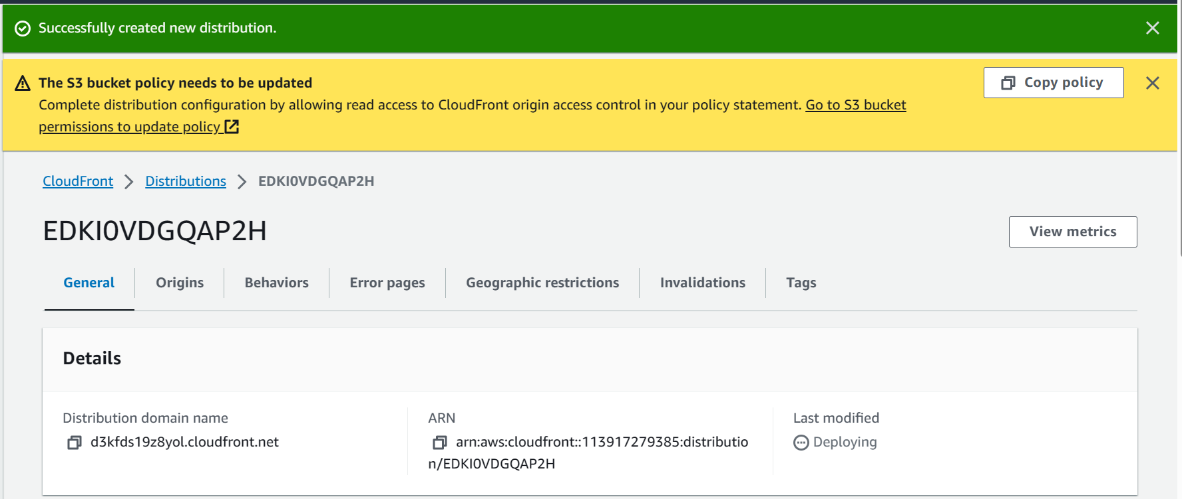
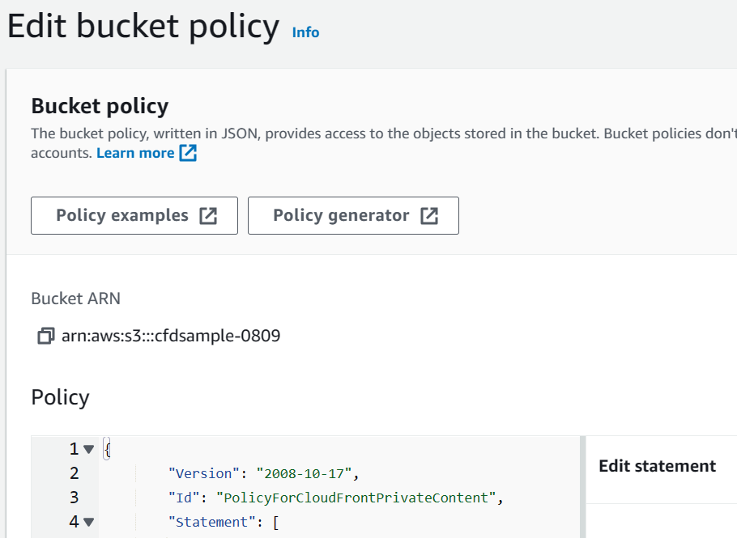
Unlimited Powerful Learning
Successfully created distribution. And also it will show update your bucket policy, to update click on copy policy and click on S3 bucket permission link.
Go to S3 bucket in that permission and paste the policy which you have copied in edit bucket policy (we allowing the cloudfront to access the S3 bucket) and save.

Slide 20
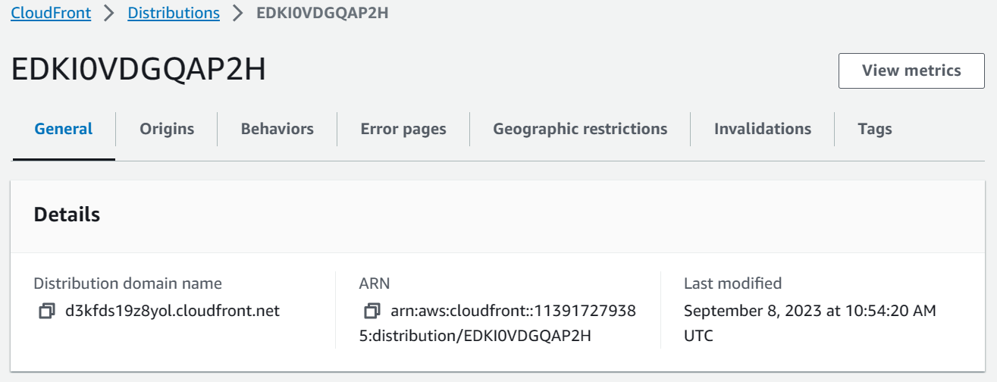
Unlimited Powerful Learning
Go back to the distributions. Distribution will be created but in the last modified there will be in deploying stage, wait until to deploy. After deploy copy the domain name and paste it any web browser. Then it will display the content which is uploaded in the S3 bucket.

Slide 21
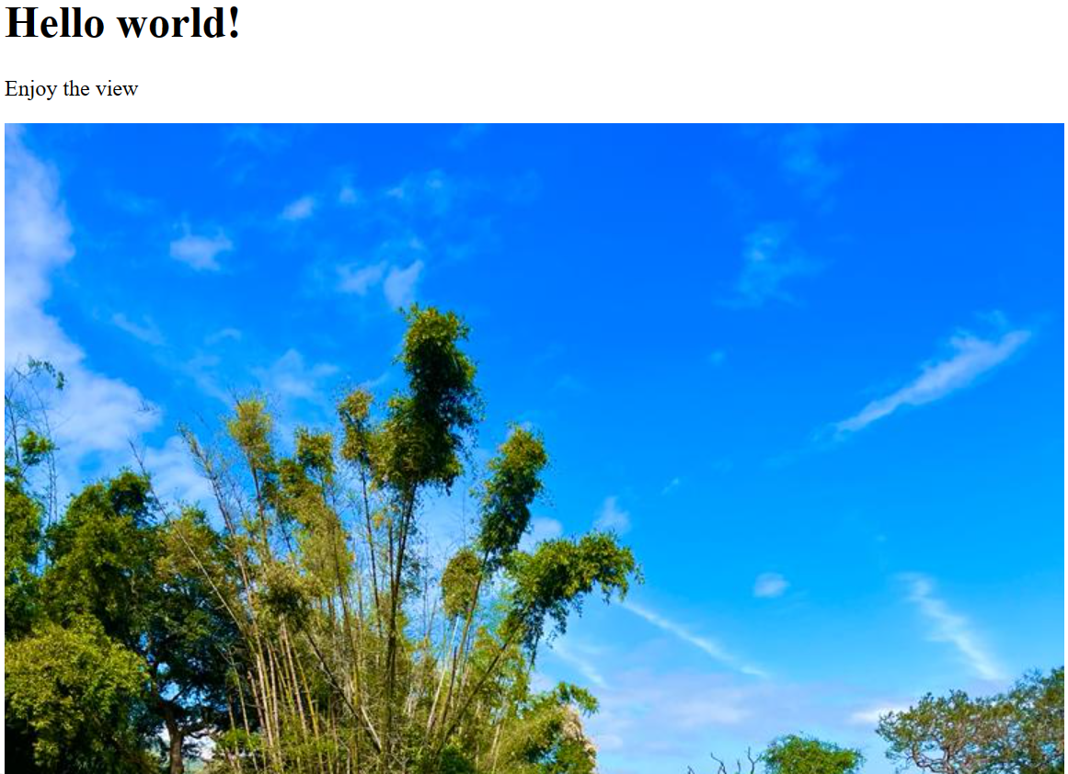
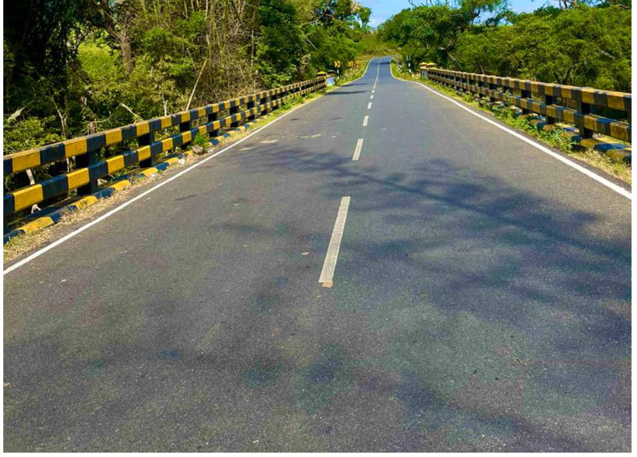
Unlimited Powerful Learning

